Slide 1


Presentation
2021863026 류연우
웹프로그래밍응용
1학기 Github

Slide 2
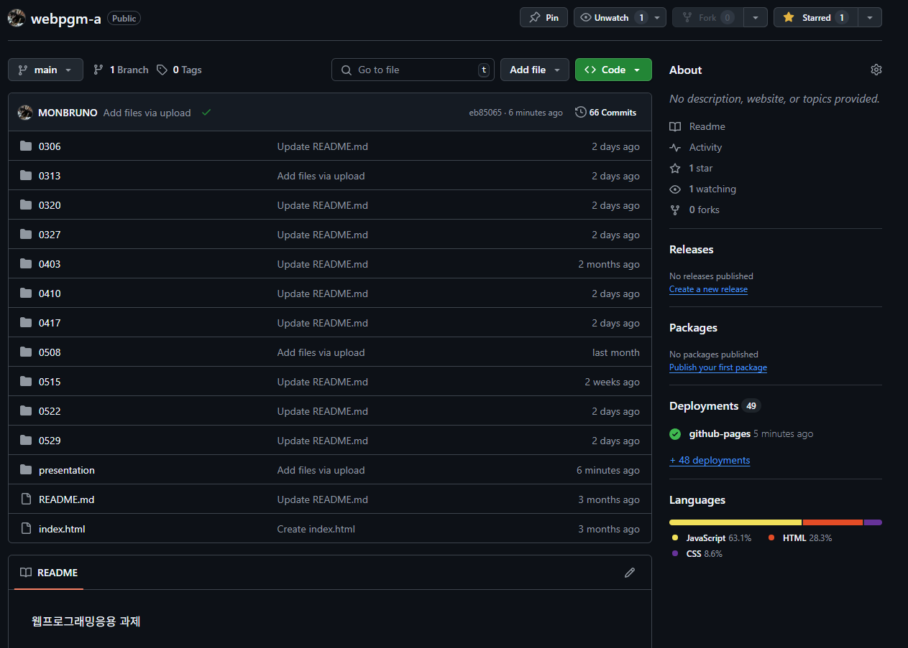
Presentation

Slide 3
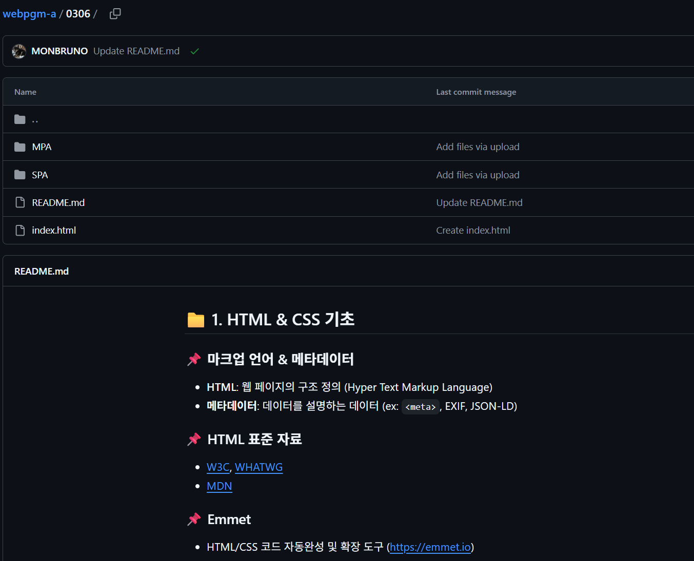
0306
Presentation
1.5

Slide 4
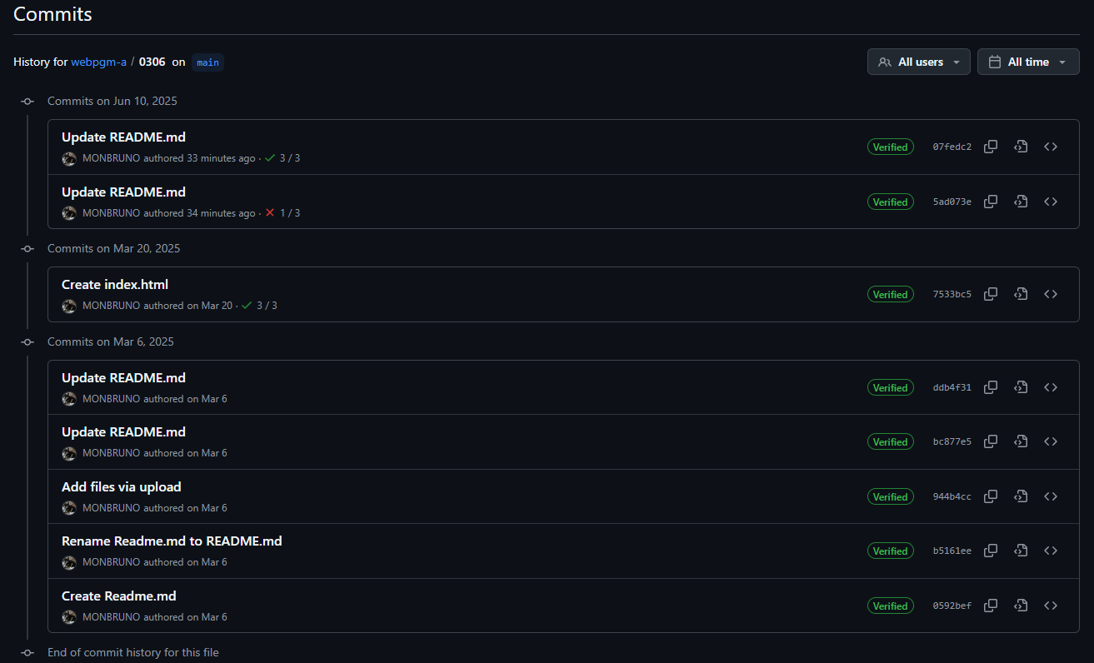
0306
Presentation
1.5

Slide 5
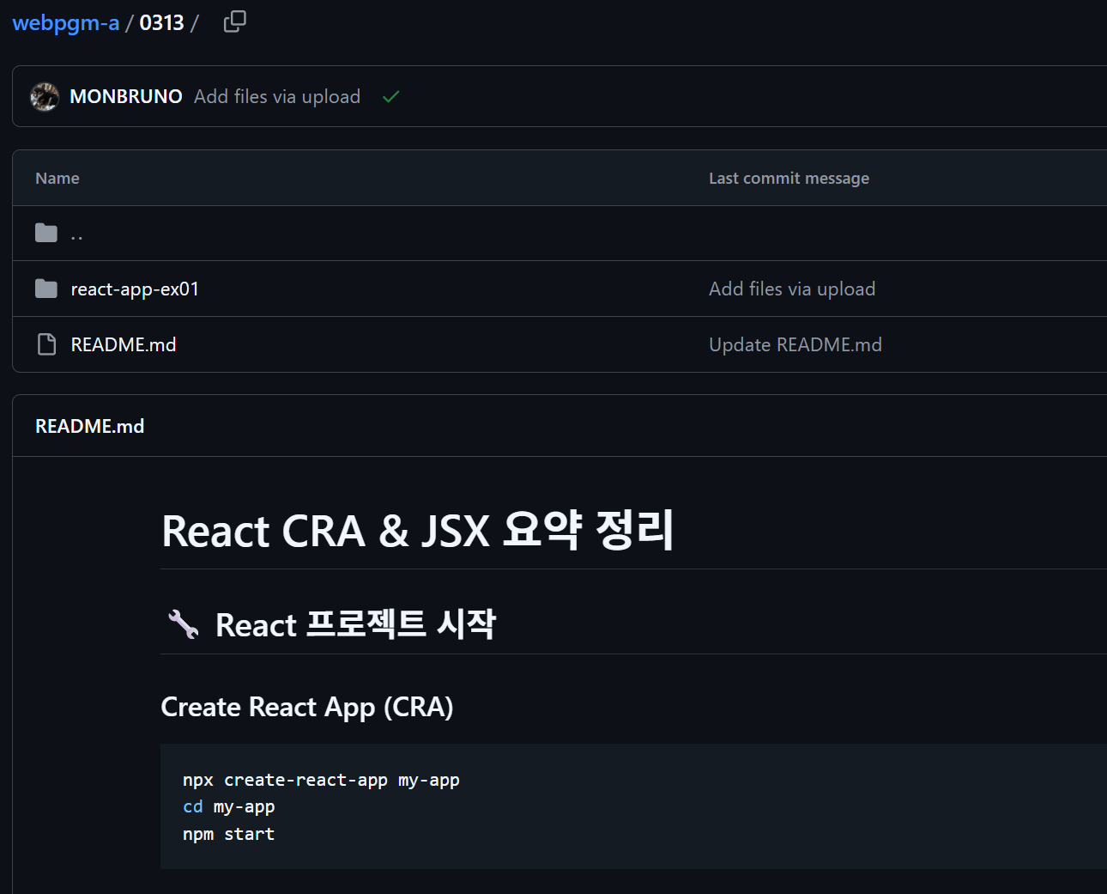
0313
Presentation
1.0

Slide 6
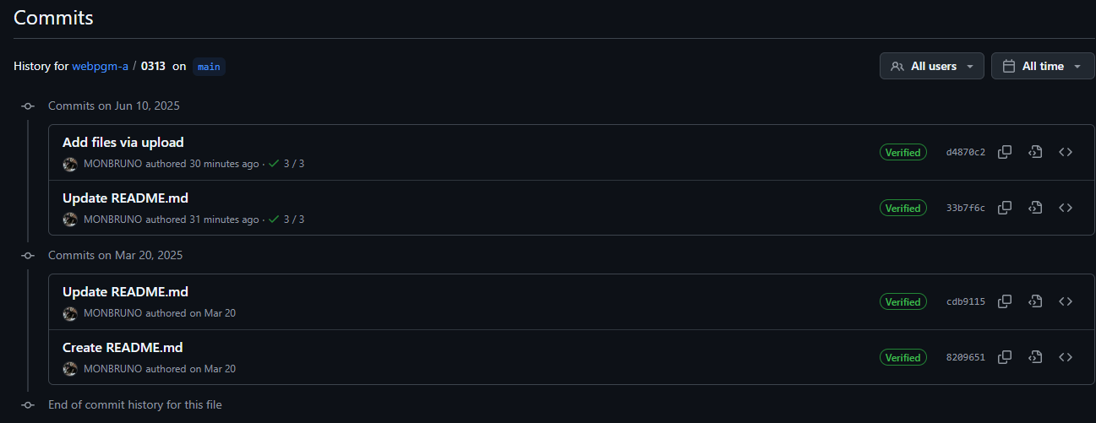
0313
Presentation
1.0

Slide 7
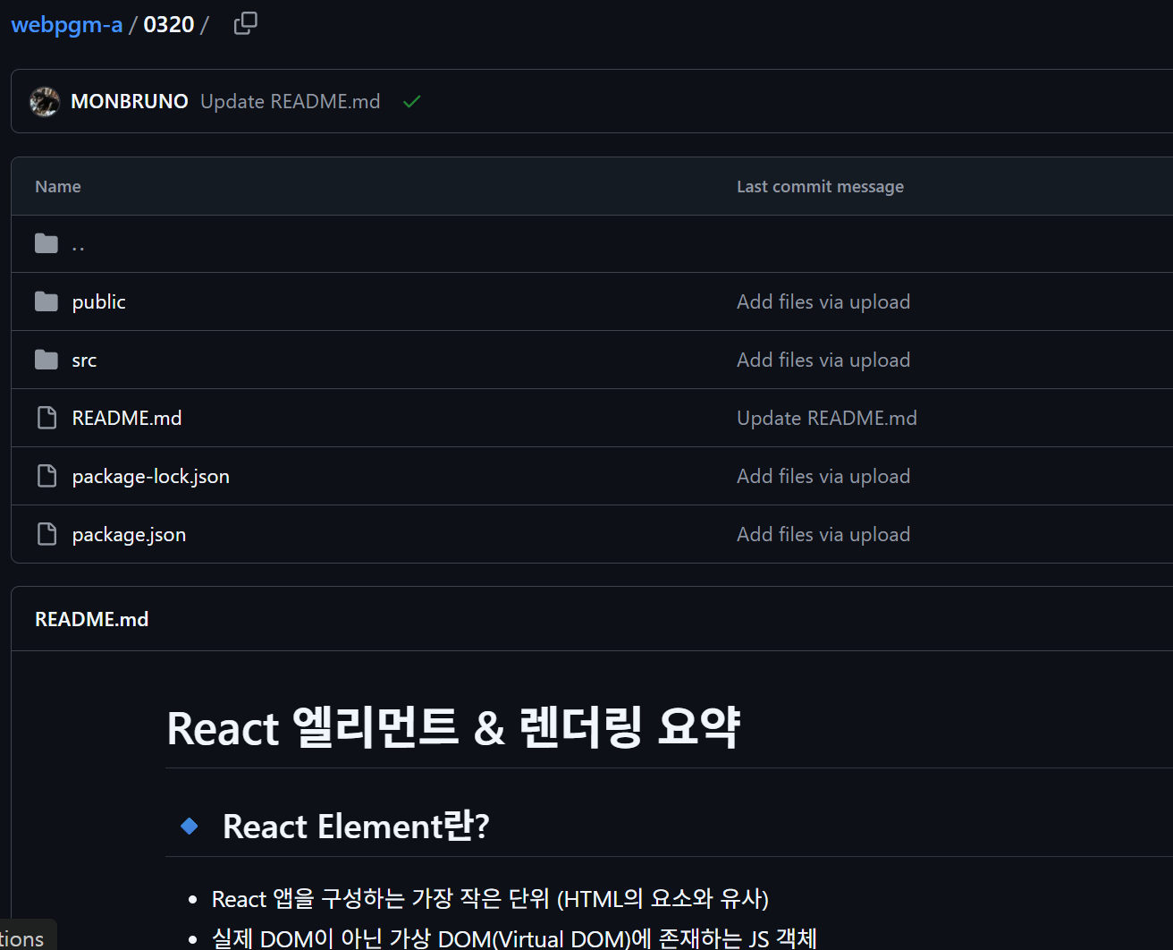
0320
Presentation
1.5

Slide 8
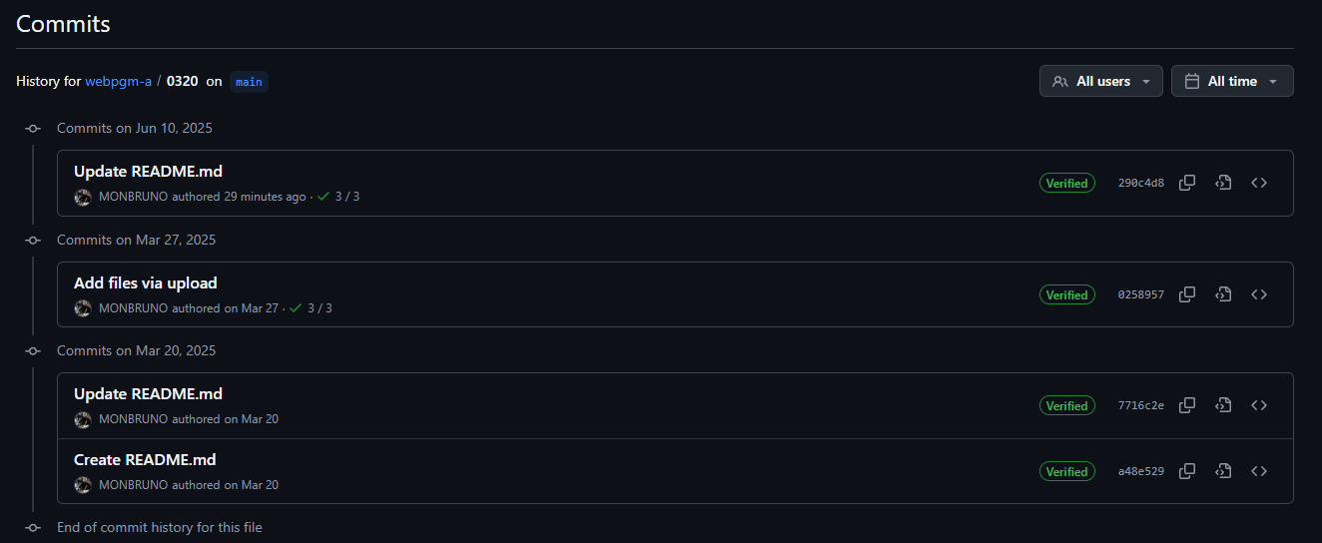
0320
Presentation
1.5

Slide 9
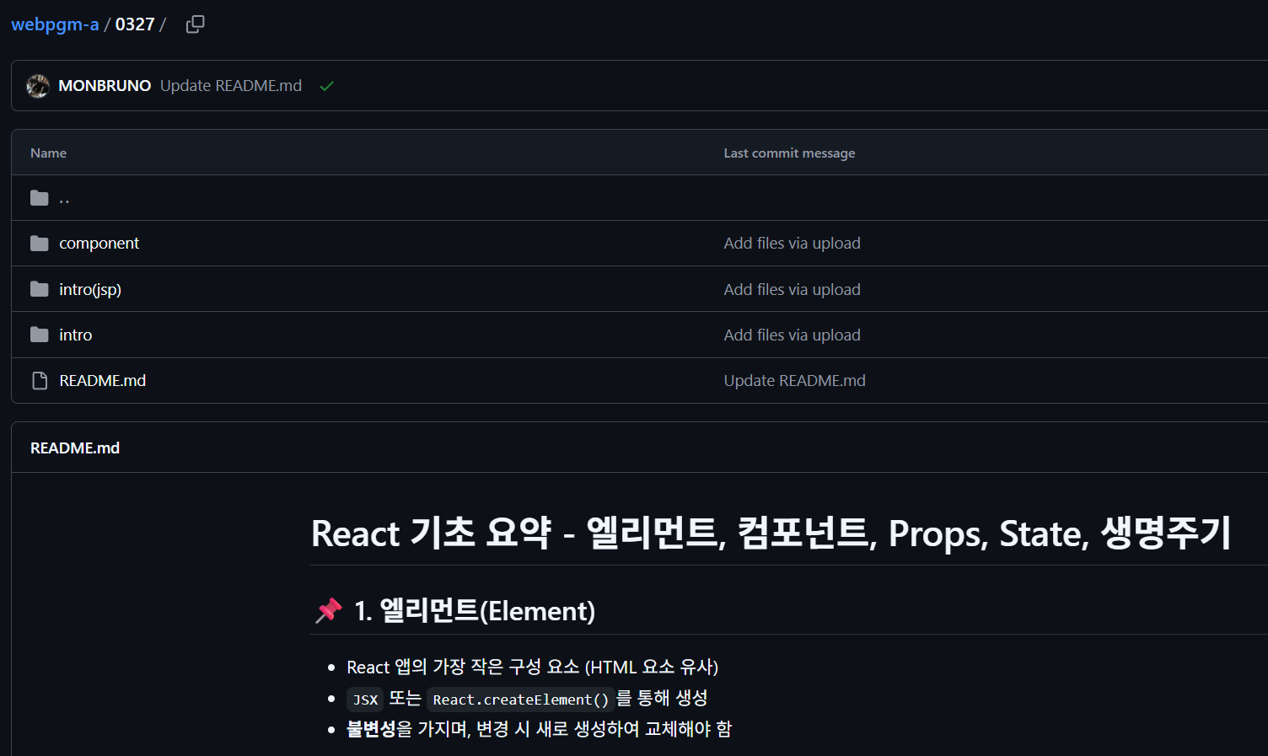
0327
Presentation
1.5

Slide 10
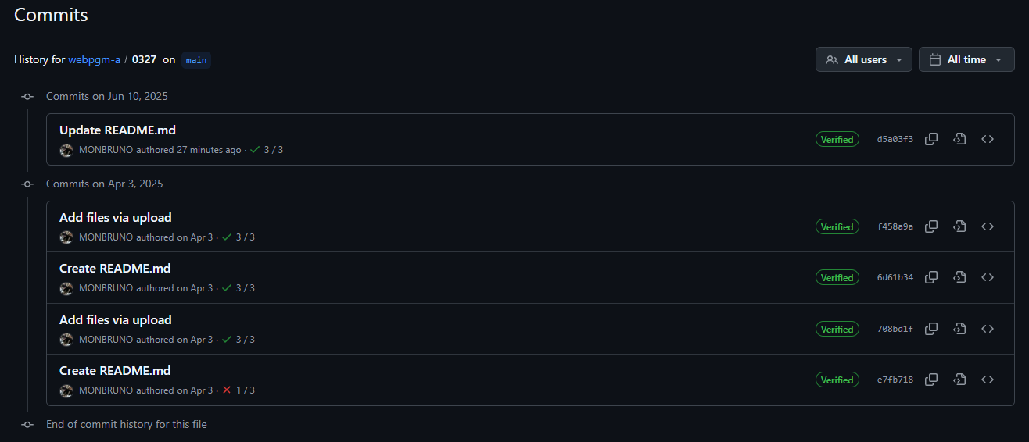
0327
Presentation
1.5

Slide 11
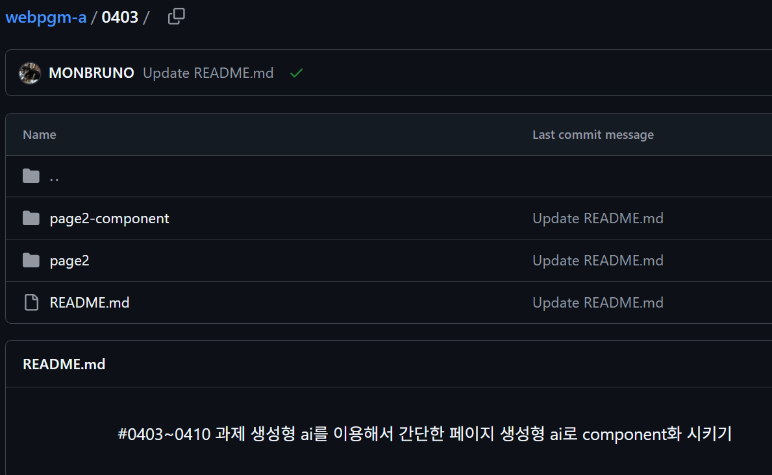
0403
Presentation
1.5

Slide 12
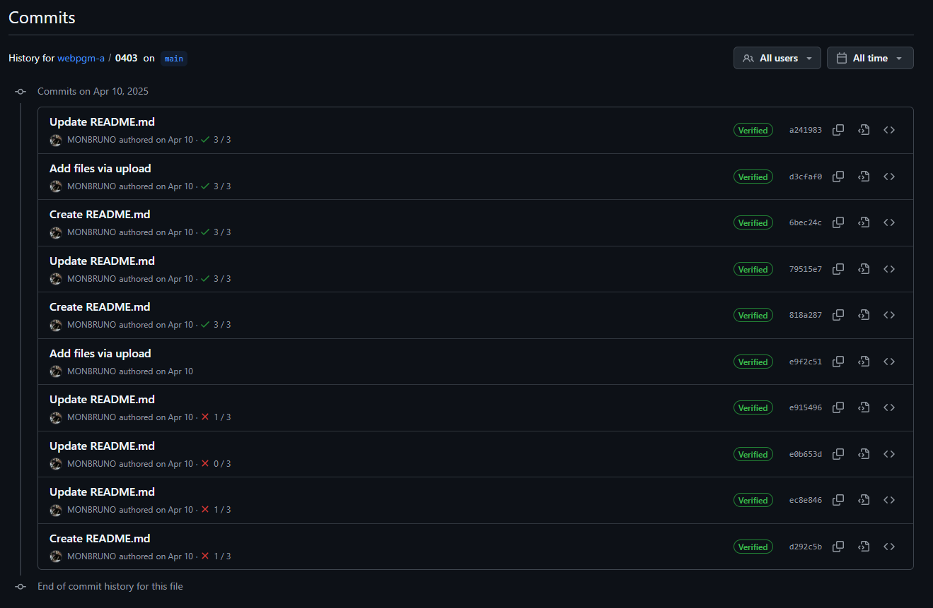
0403
Presentation
1.5

Slide 13
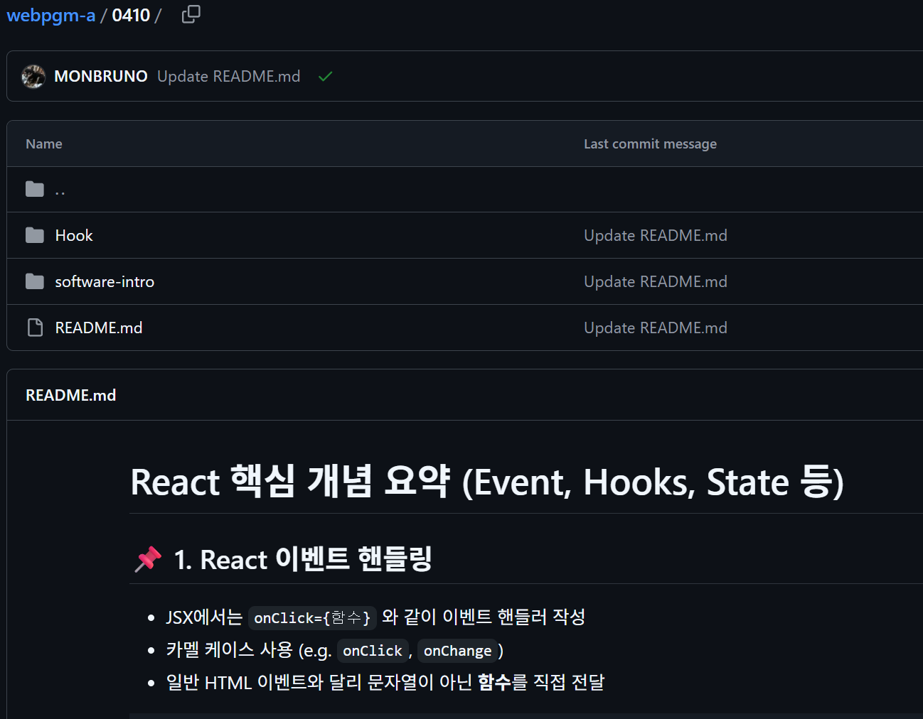
0410
Presentation
1.5

Slide 14
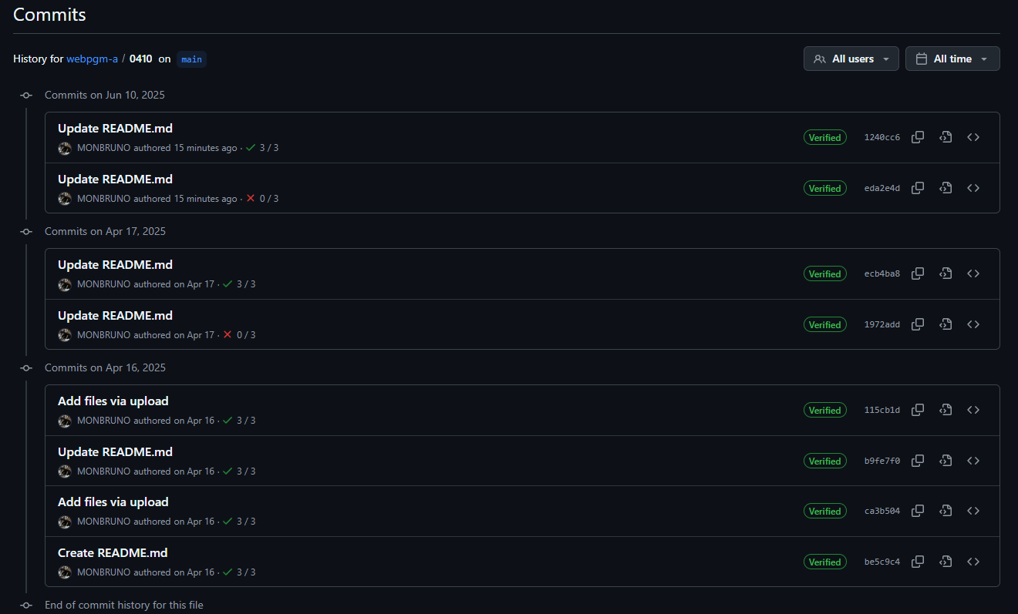
0410
Presentation
1.5

Slide 15
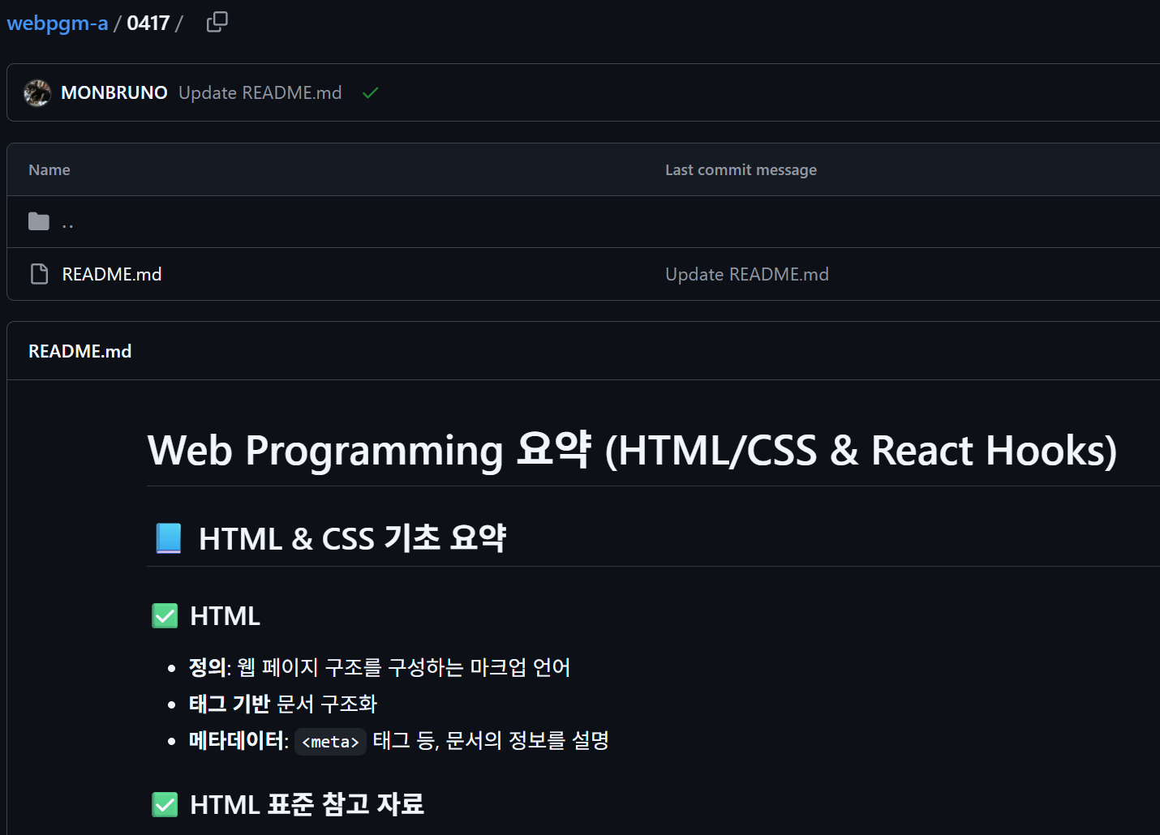
0417
Presentation
1.5

Slide 16
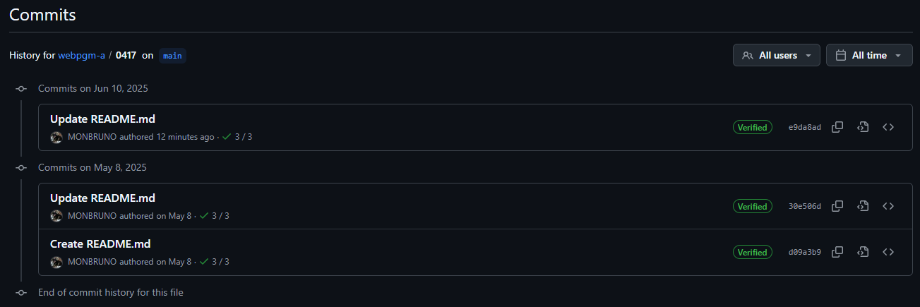
0417
Presentation
1.5

Slide 17
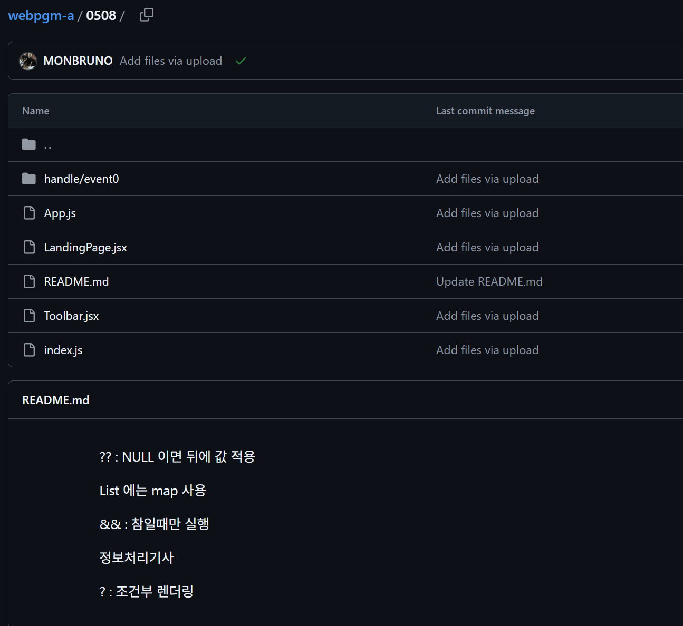
0508
Presentation
1.5

Slide 18
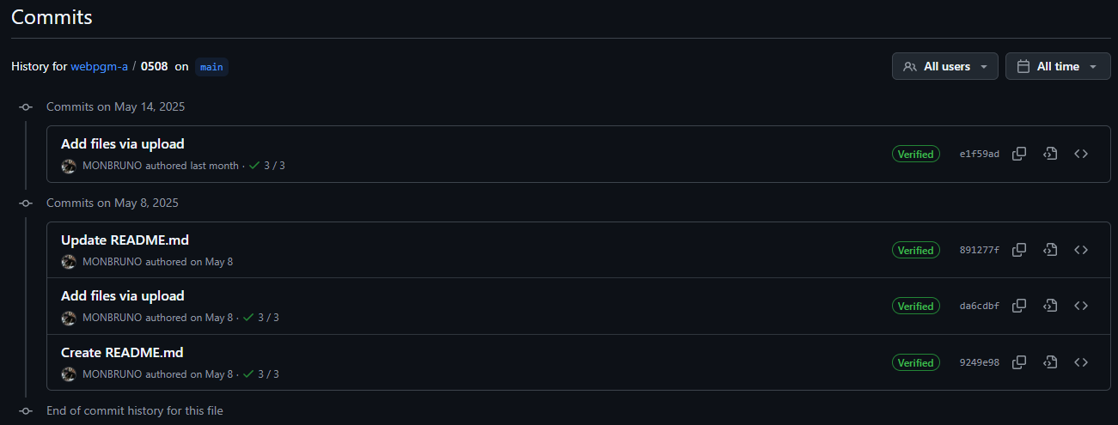
0508
Presentation
1.5

Slide 19
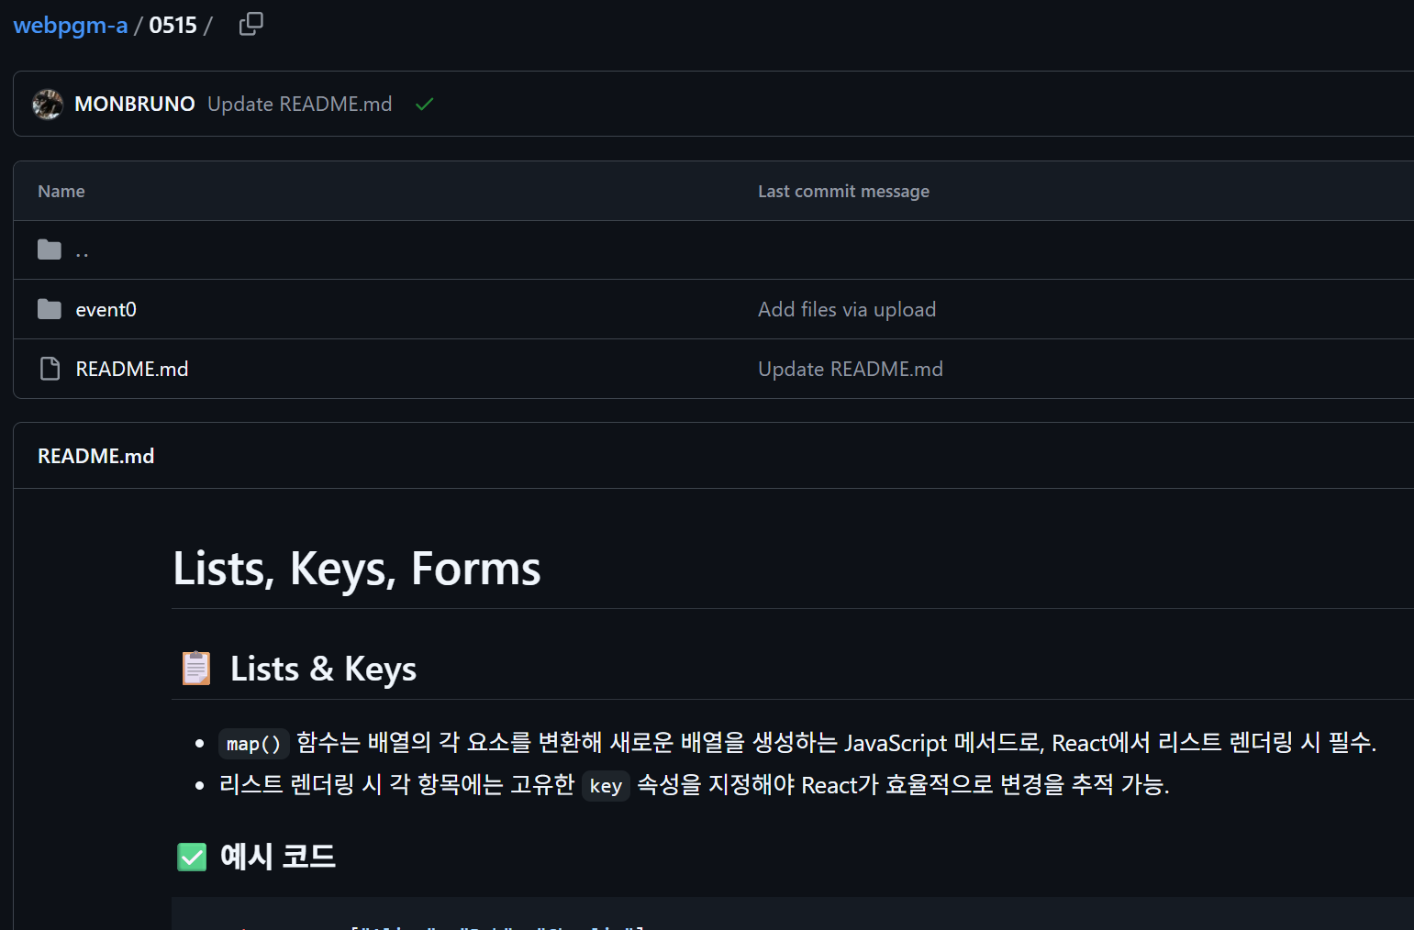
0515
Presentation
1.5

Slide 20
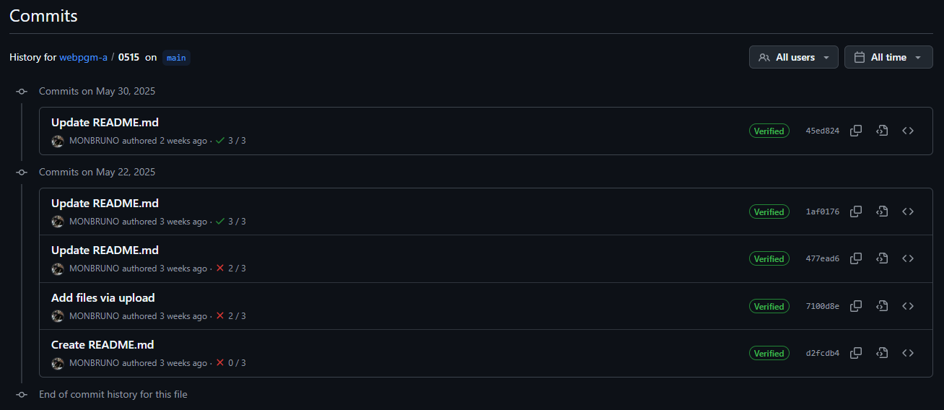
0515
Presentation
1.5

Slide 21
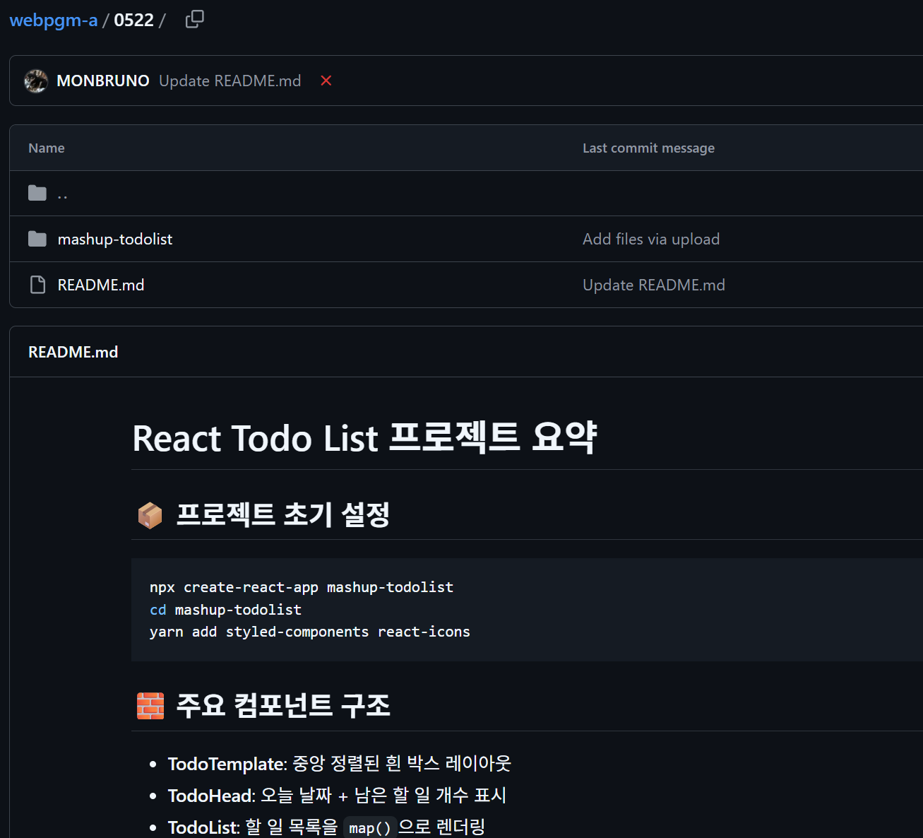
0522
Presentation
1.0

Slide 22
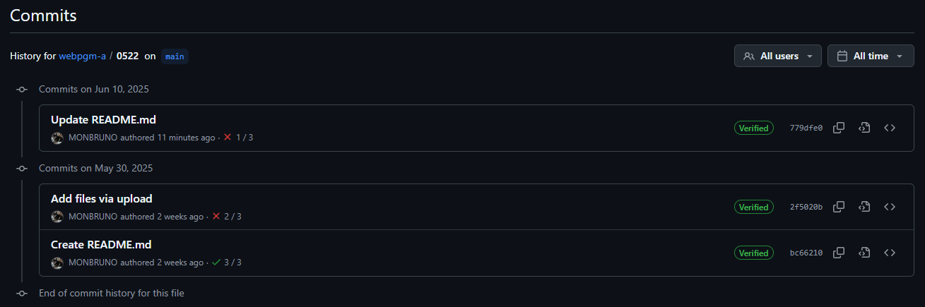
0522
Presentation
1.0

Slide 23
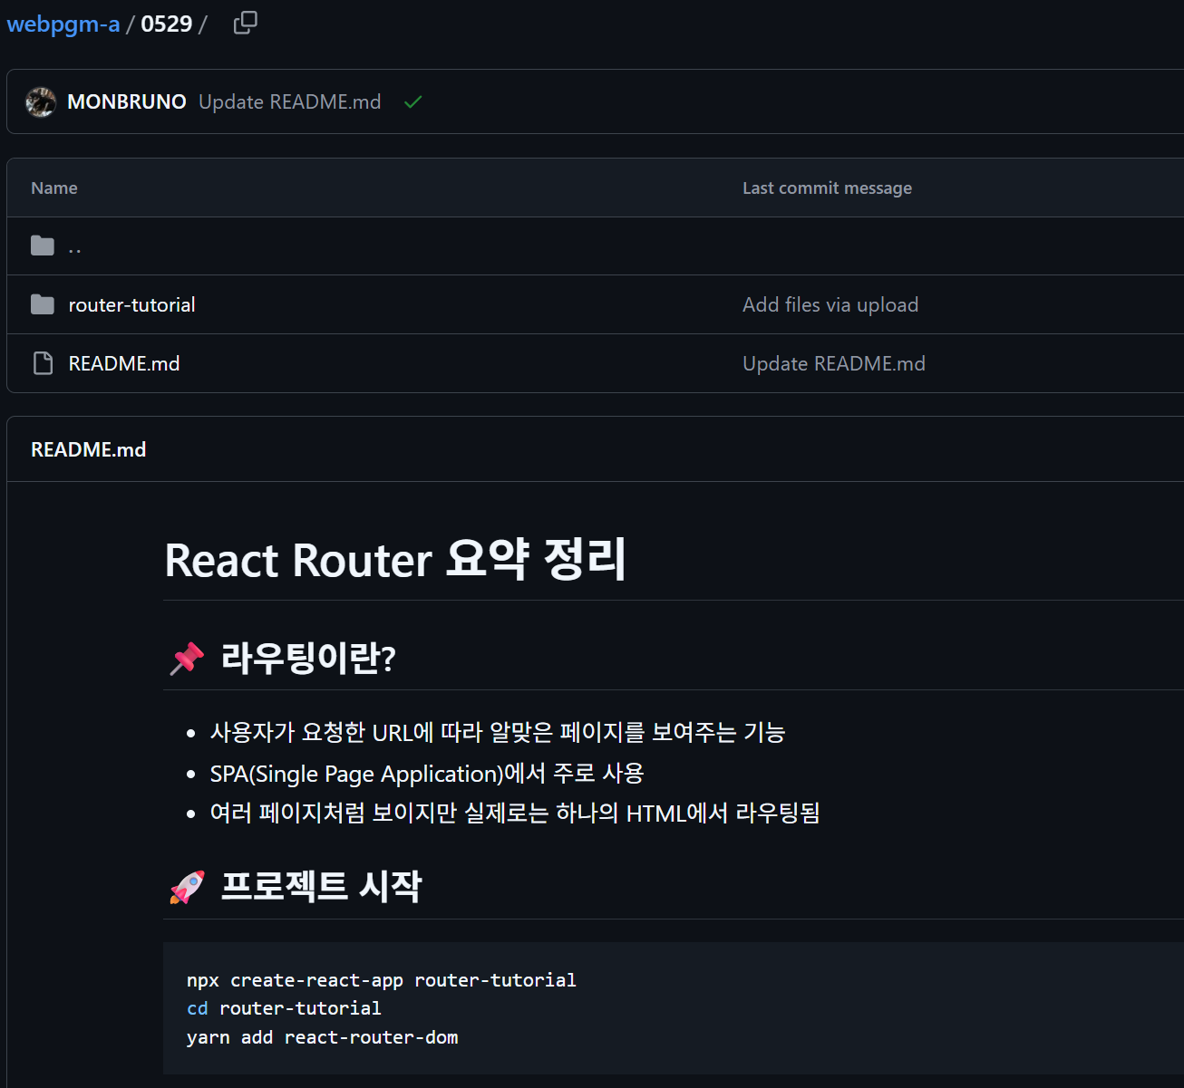
0529
Presentation
1.5

Slide 24
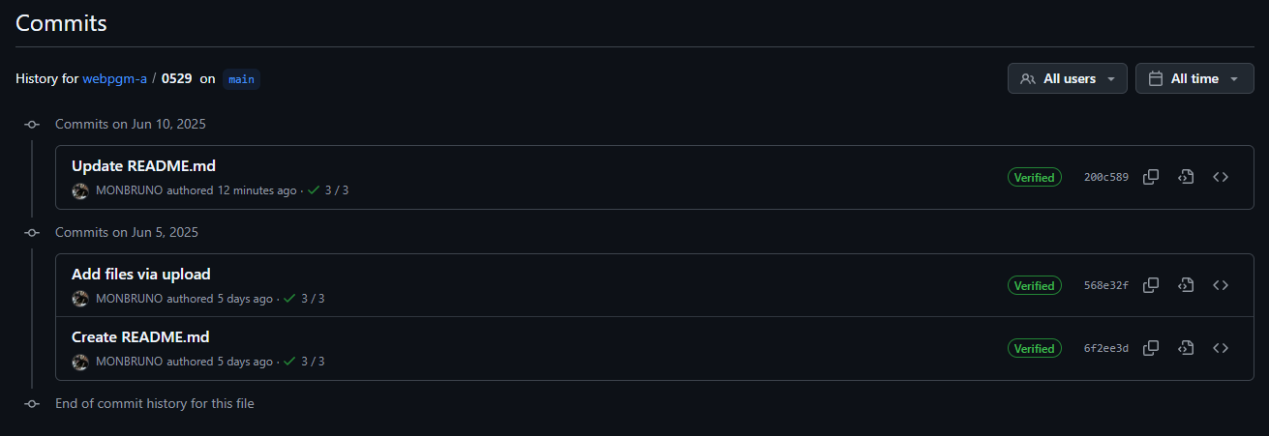
0529
Presentation
1.5

Slide 25
총점
Presentation
1.0 X 2
+ 1.5 X 9
= 15.5
15.5 점
https://github.com/MONBRUNO

Slide 26




Presentation
Thank You!

